Slide 1
Objects in the solar system
Formation of the solar system
Notes:
Great Kurzgesagt video on the Solar System: https://www.youtube.com/watch?v=KsF_hdjWJjo

Slide 2
Solar System
Structure

Slide 3
Recap
Geocentric models of the Solar System were accepted based on what assumptions?
What evidence pointed towards Heliocentrism?
Give one example of how astronomy influenced ancient culture.

Slide 4
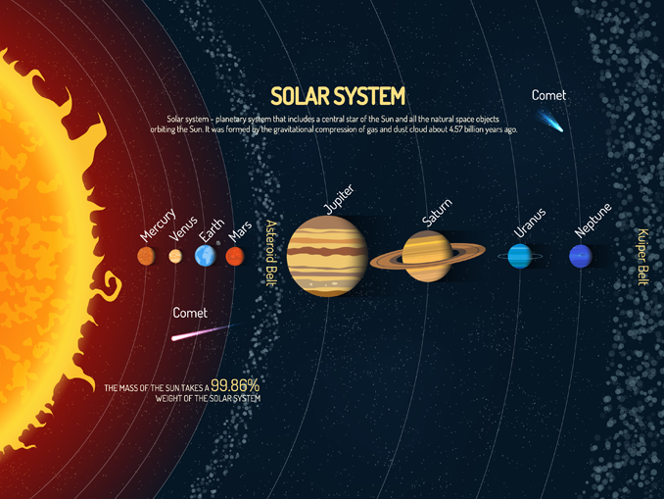
Not to Scale!
EARTHHOW
Notes:
Diagram of the SS by EarthHow: https://earthhow.com/solar-system-facts/
Oort cloud not shown!
Formed 4.571 billion years ago
Earth ~ 4.543 billion years

Slide 5
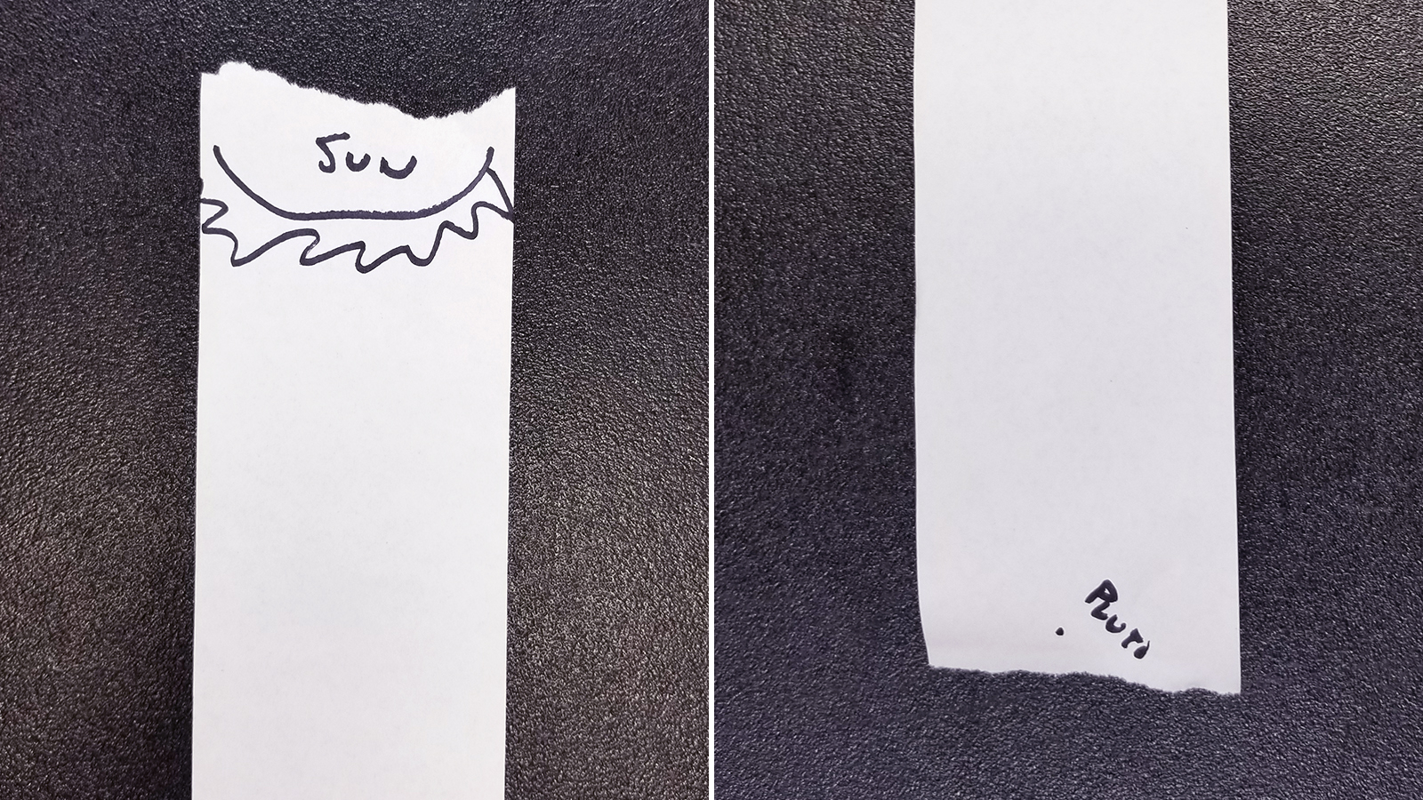
Scale of the Solar System
NASA/JPL
Notes:
Activity to get students to understand the scale of the SS (AA001 - https://www.jpl.nasa.gov/edu/teach/activity/solar-system-scroll/)
Get a long piece of paper and place the Sun and Pluto at opposite ends.

Slide 6
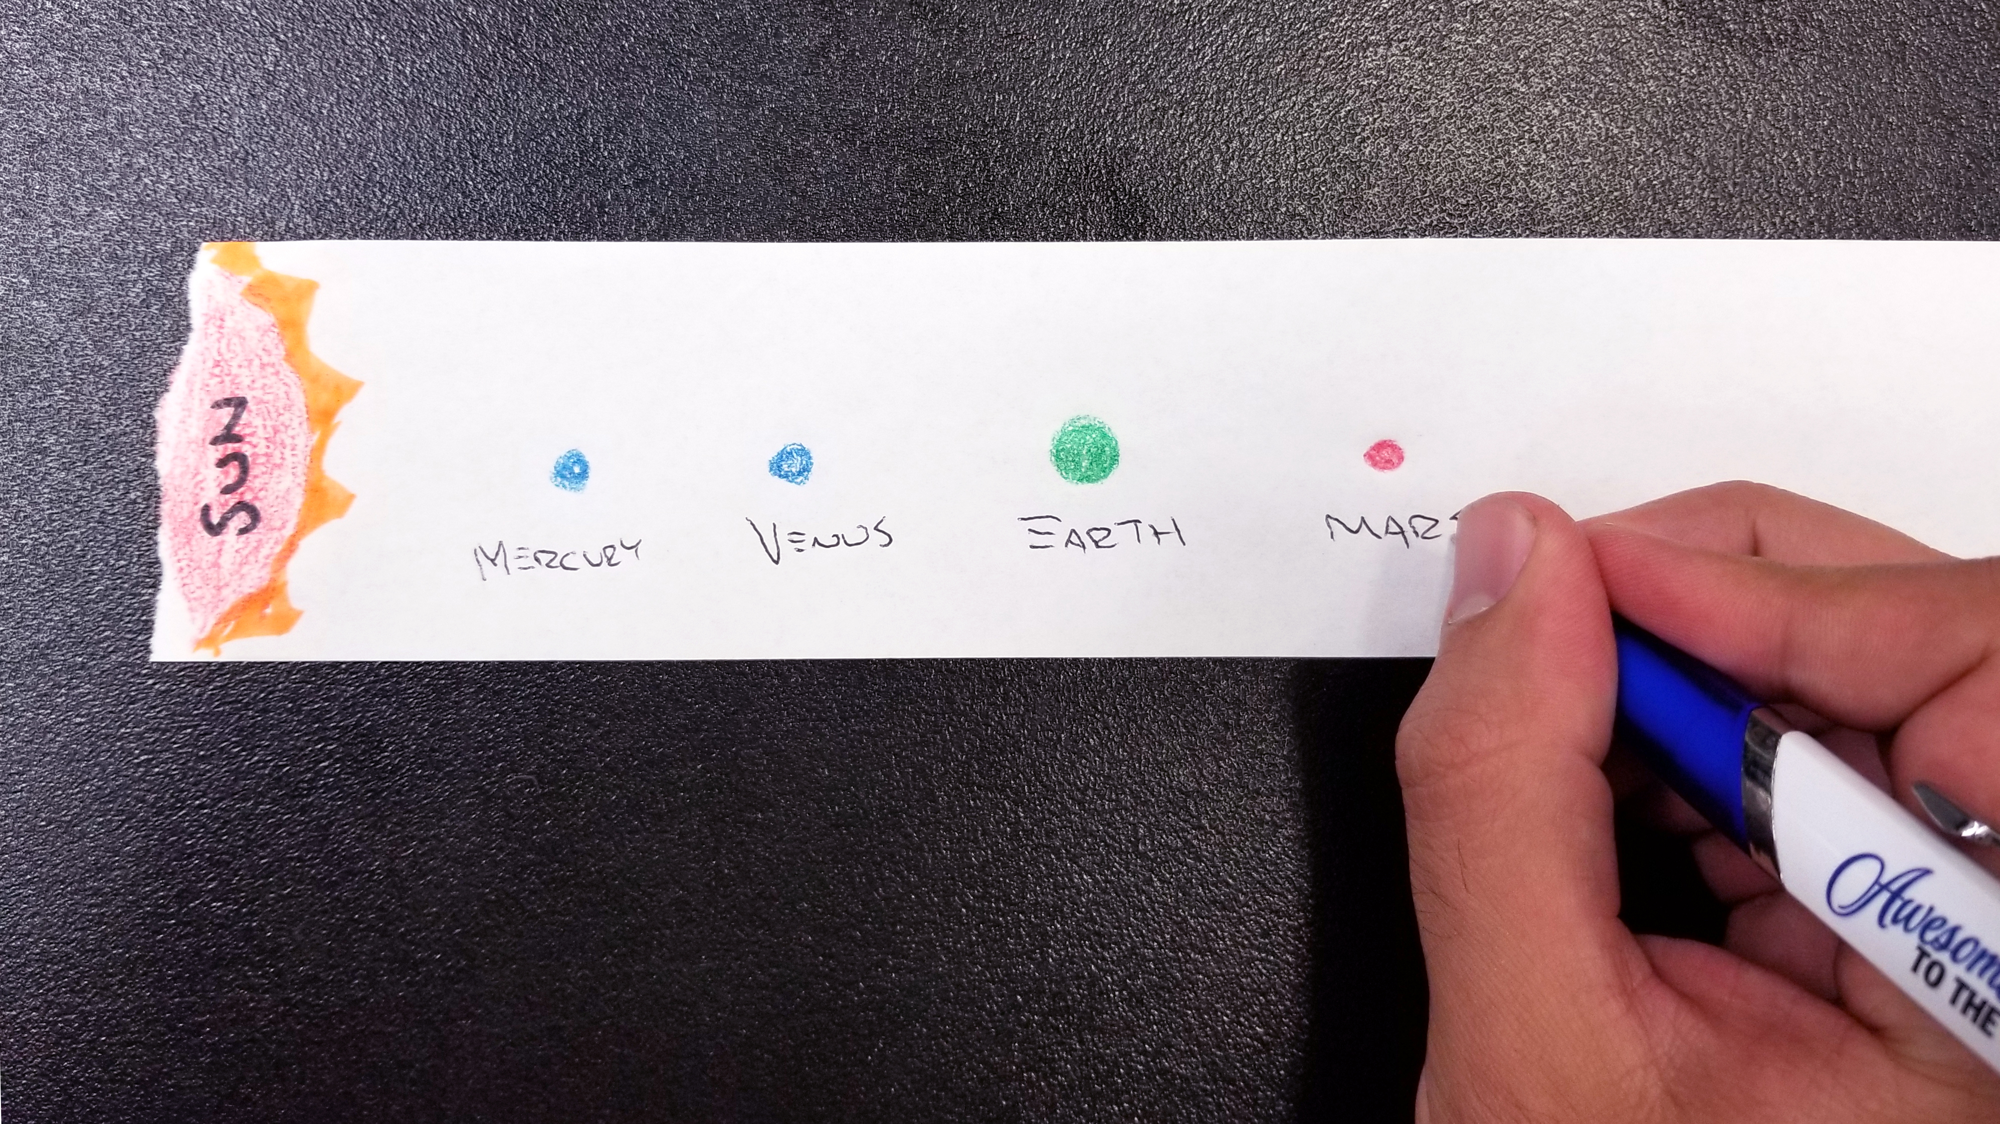
Scale of the Solar System
NASA/JPL
Notes:
Now get students to guess the locations of the planets on the roll.

Slide 7
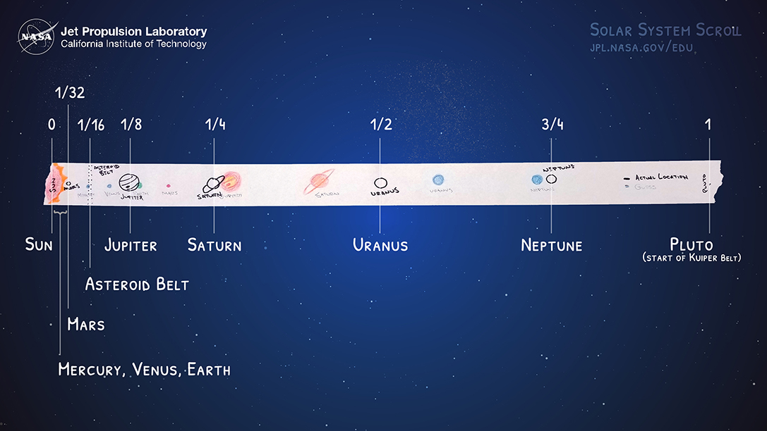
NASA/JPL
Notes:
Actual positions!

Slide 8
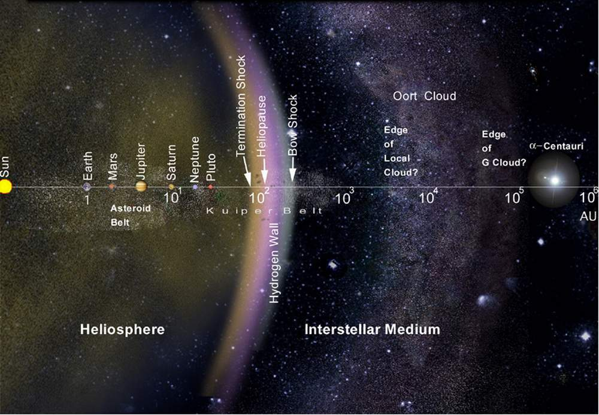
Solar System
1 AU = 1.495978707×10¹¹ m
NASA
Notes:
Image from an article about Voyager: https://voyager.jpl.nasa.gov/mission/did-you-know/
The Oort cloud extends to 1/5 the distance to the nearest star!
Notice the log scale
Termination shock – particles slow to less than the speed of sound
Heliopause – pressure from outside is the same as from the solar wind
Theoretical wall of Hydrogen just after the heliopause
Little to no bow shock around our Sun.
Oort cloud marks edge of gravitational influence of the Sun. All of that is embedded in the Local Cloud next to the G cloud which contains alpha Centauri. Outside the Oort cloud is interstellar space.

Slide 9
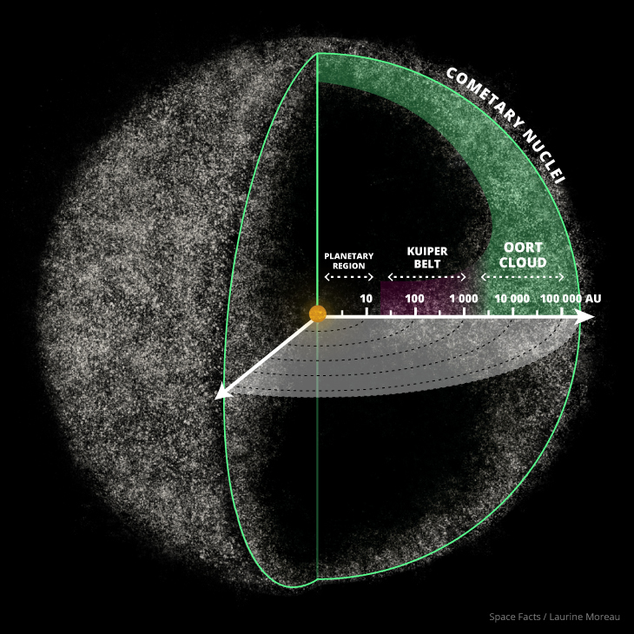
Solar System
Space Facts/Laurine Moreau
Notes:
Zoomed out to see the spherical shape of the cloud
Hard to visualise large numbers try making as many tallies on a piece of paper that you can in 60 s. How long would it take us to make a million tallies?
These are huge numbers!
Inner Oort cloud is disk shaped after Kuiper Belt and the outer cloud is spherical. Source of long period comets!

Slide 10
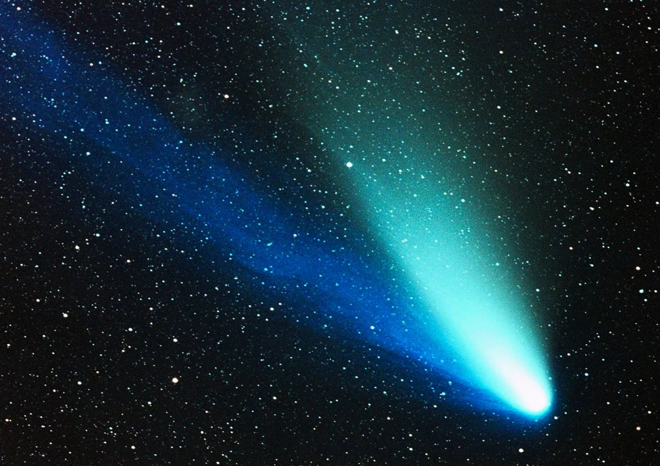
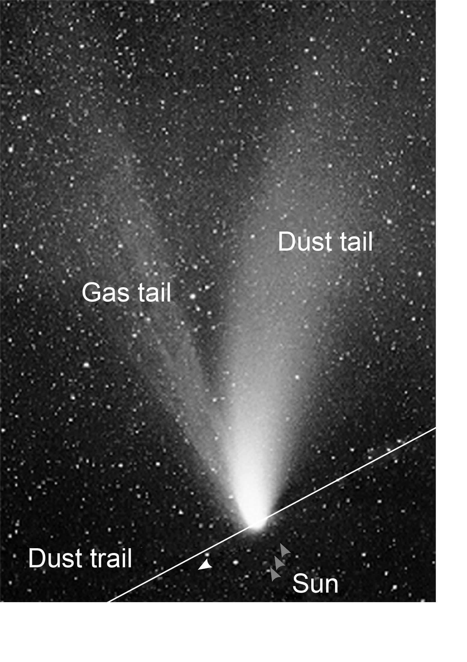
Comets
Comet Hale–Bopp
Short-period comets originate in the Kuiper belt or its associated scattered disc. Long-period comets are thought to originate in the Oort cloud.
NASA Ames Research Center/K. Jobse, P. Jenniskens
Notes:
NASA Ames Research Center/K. Jobse, P. Jenniskens
Main image source unknown

Slide 11
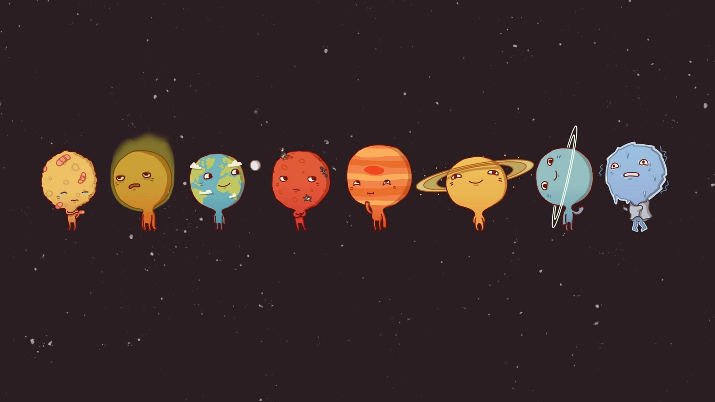
There are 8 planets!
Can you name them?
Notes:
Image Author Unknown
Can you name the planets in order?

Slide 12
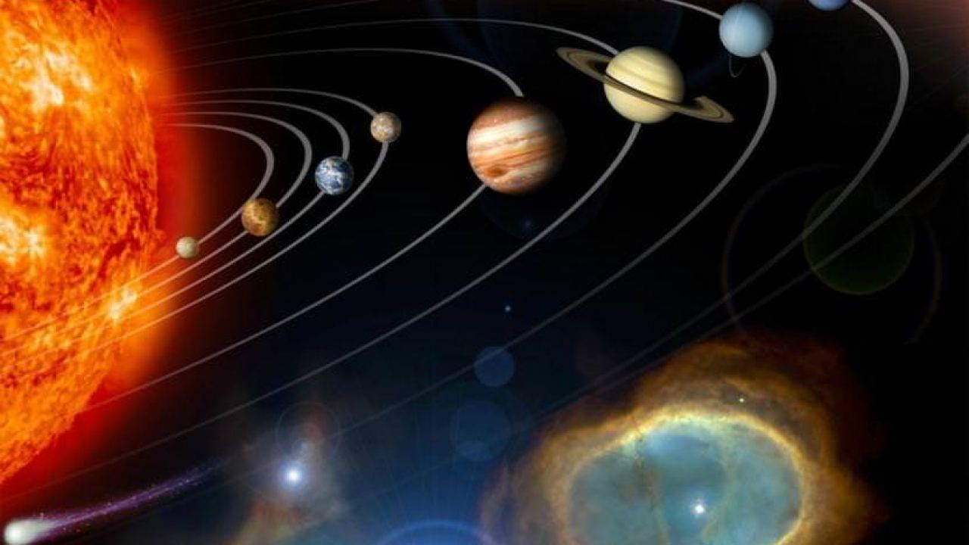
Mercury | My
Venus | Vicious
Earth | Earthworm
Mars | Might
Jupiter | Just
Saturn | Swallow
Uranus | Us
Neptune | Now
Linda Chisholm
Notes:
Easy way to remember the order.

Slide 13
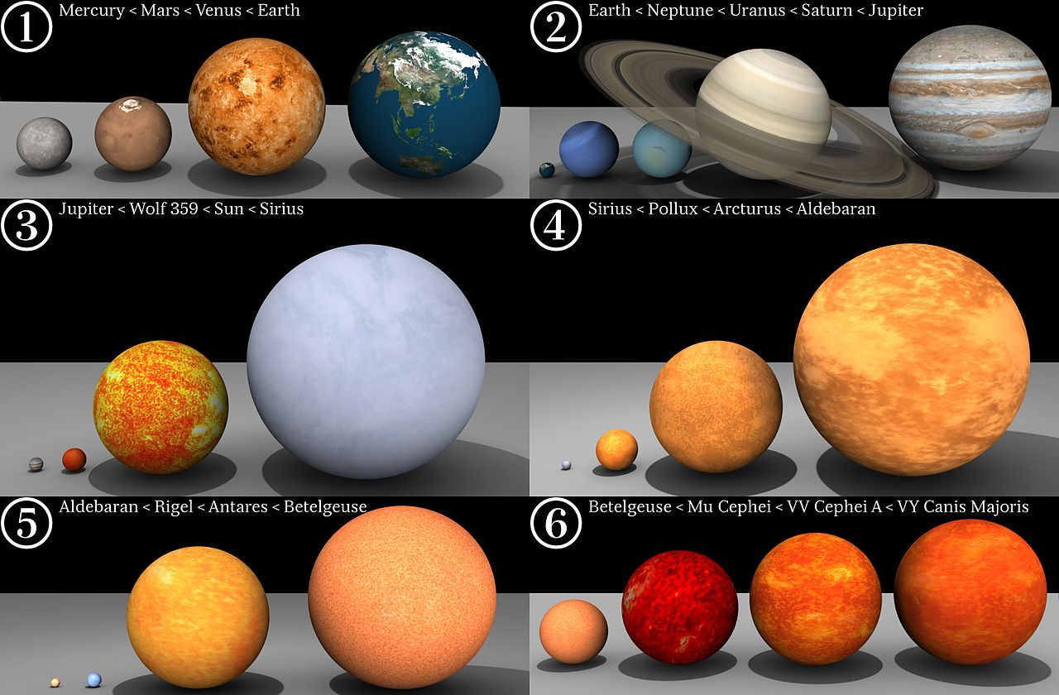
Dave Jarvis
Notes:
Planets to scale with stars for comparison.

Slide 14
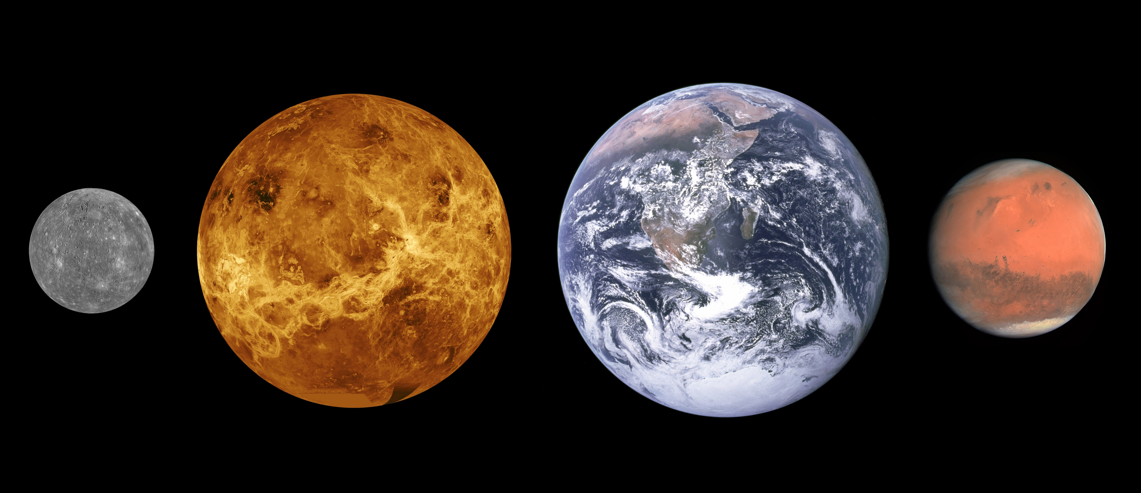
The Rocky Planets
Notes:
Mercury image: NASA/JHUAPL Venus image: NASA Earth image: NASA/Apollo 17 crew Mars image: ESA/MPS/UPD/LAM/IAA/RSSD/INTA/UPM/DASP/IDA
Scales are roughly correct, distances between them not so much.

Slide 15
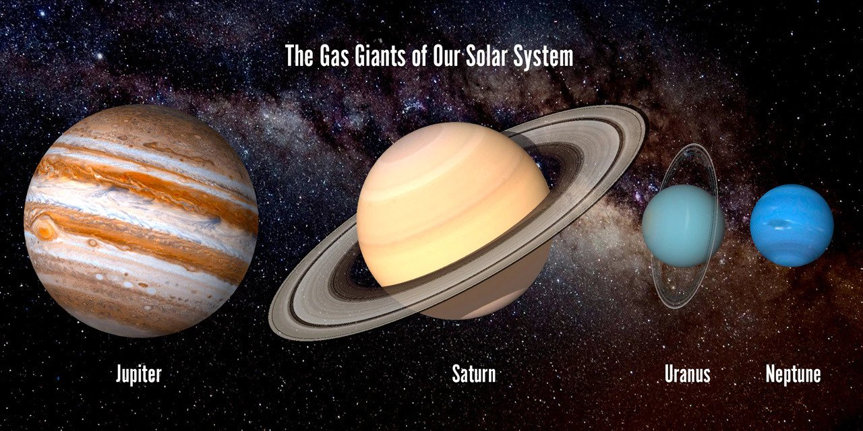
Notes:
Author Unknown

Slide 16
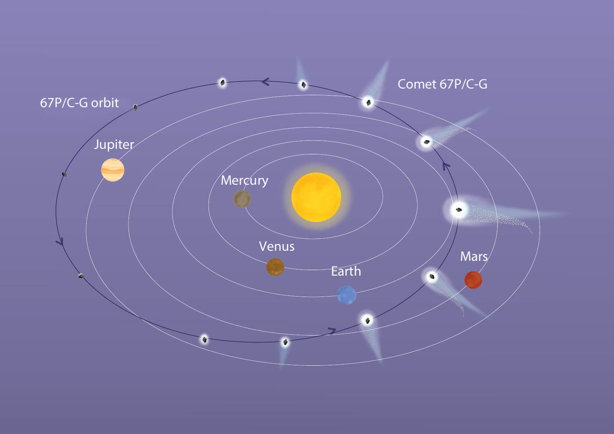
Jupiter Family Comets
These originate from the Kuiper belt. They are often collisional fragments thrown towards Jupiter by Neptune's gravity. Jupiter then traps them in orbit.
ESA

Slide 17
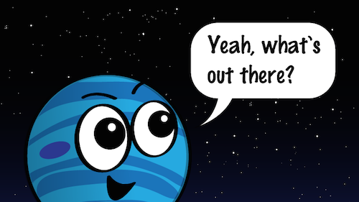
Beyond Neptune

Slide 18
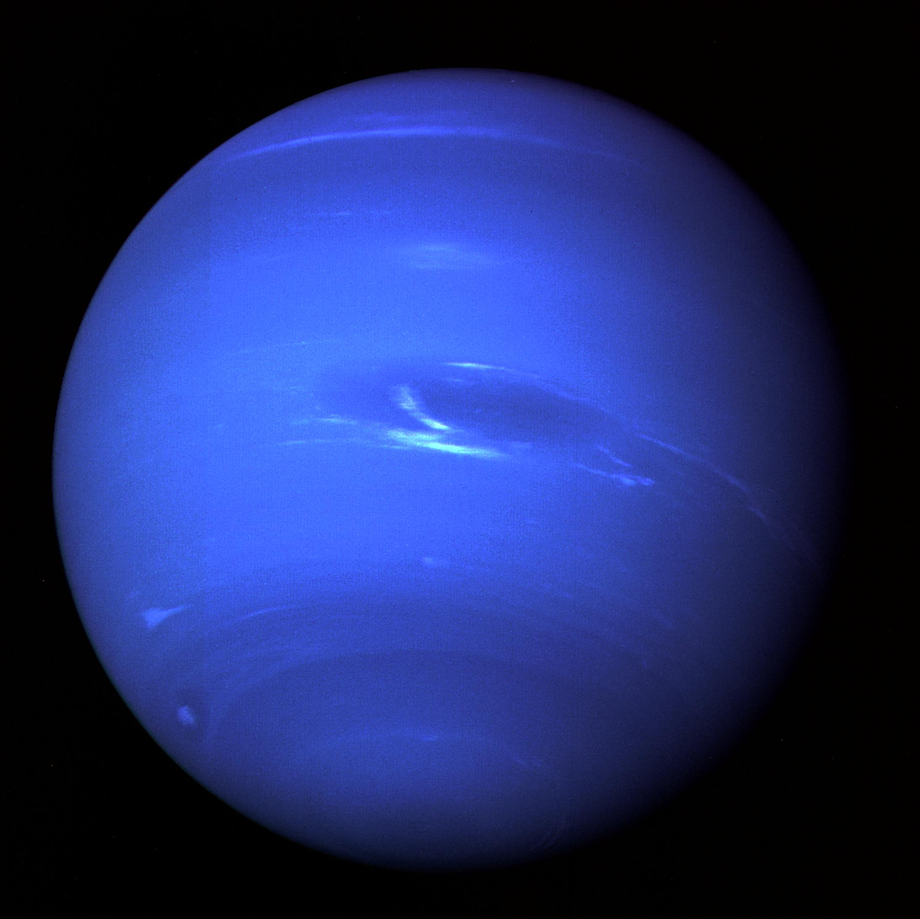
TNO’s
Trans-Neptunian Objects
Minor planets/small solar
system bodies.
Orbit with semi major axis (a) greater than Neptune's – 30 AU.
These make up the Kuiper Belt and Oort Cloud
NASA/JPL
Notes:
Voyager 2 30/10/1998 of Neptune, TNO *2 mass asteroid belt (exc Oort), 10% binary, very red mostly ice and rock.

Slide 19
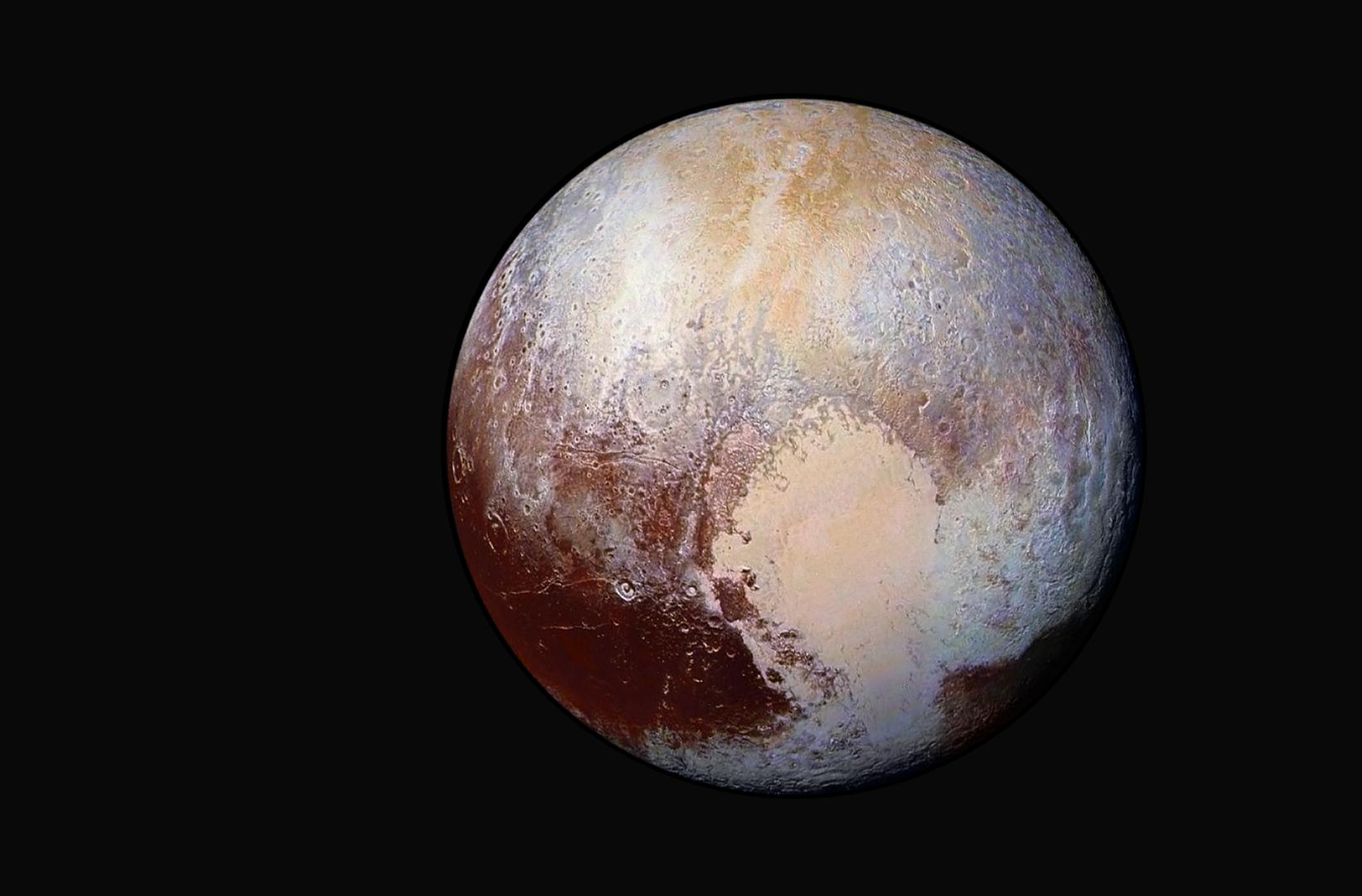
Pluto The first TNO
JPL/NASA
Notes:
Visited by New Horizons in 2015 – extension Jan 2019 flyby of KBO (486958) 2014 MU₆₉ (PT1) Disc 1930, 70% rock and 30% ice. 2/3 moon radius , Charon ½ r pluto

Slide 20
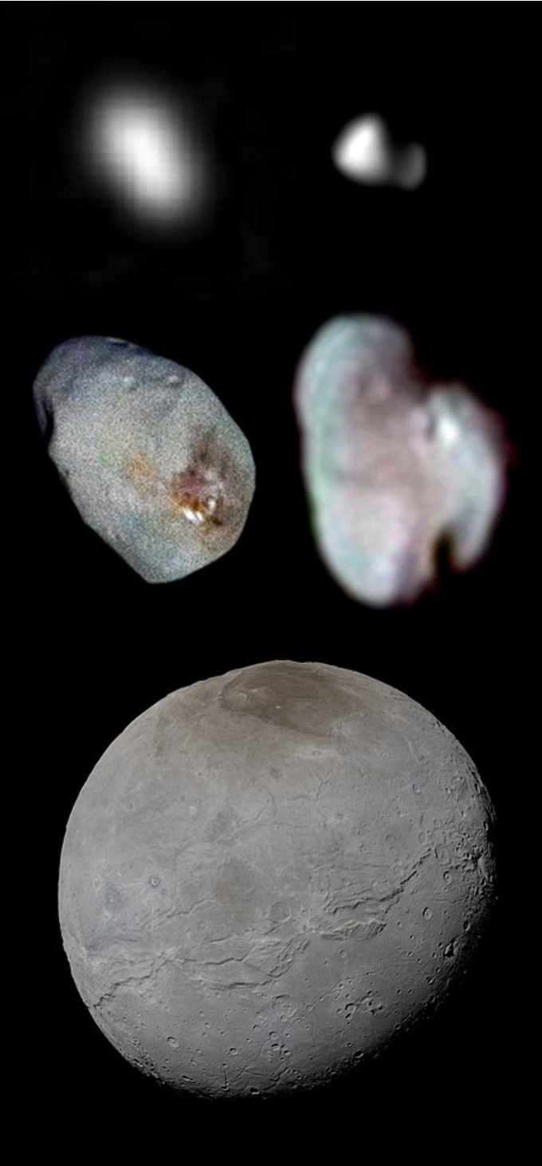
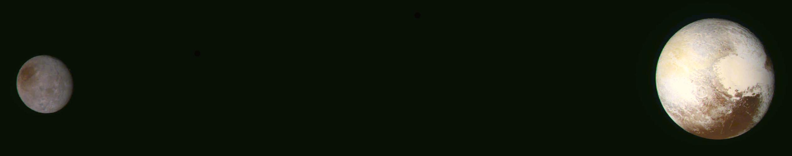
Pluto’s Moons
NASA/JHU-APL/SwRI/JPL
Notes:
Top: Styx (left) and Kerberos (right) Middle: Nix (left) and Hydra (right) Bottom: Pluto's largest moon, Charon, with its dark Mordor Macula NTS
NASA/Johns Hopkins University Applied Physics Laboratory/Southwest Research Institute PIA19856: A Binary Planet in Color

Slide 21
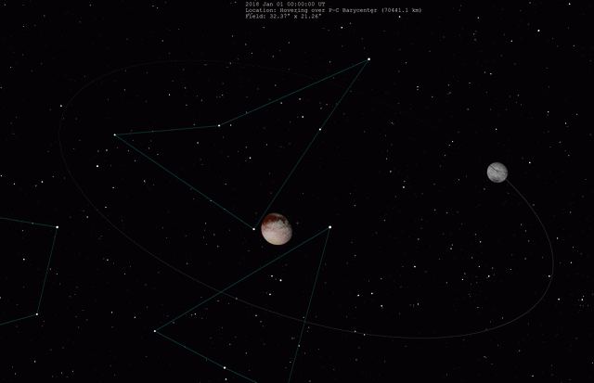
Notes:
Animation of Charon and Pluto orbiting their barycentre (a point in space just outside the surface of Pluto)

Slide 22
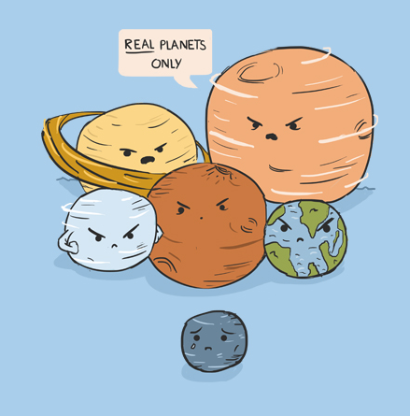
From Planet to Dwarf Planet
IAU Resolution 5B
“A celestial body that (a) is in orbit around the Sun, (b) has sufficient mass for its self-gravity to overcome rigid body forces so that it assumes a hydrostatic equilibrium (nearly round) shape, and (c) has cleared the neighbourhood around its orbit.”
https://www.iau.org/static/resolutions/Resolution_GA26-5-6.pdf
dragallur.wordpress.com
Notes:
1992 Jewitt and Luu observed object 1992 QB1 (cubewano). Then started to find lots of other objects in resonance with Neptune (Plutinos). 2006 IAU changed definition of Planet.

Slide 23
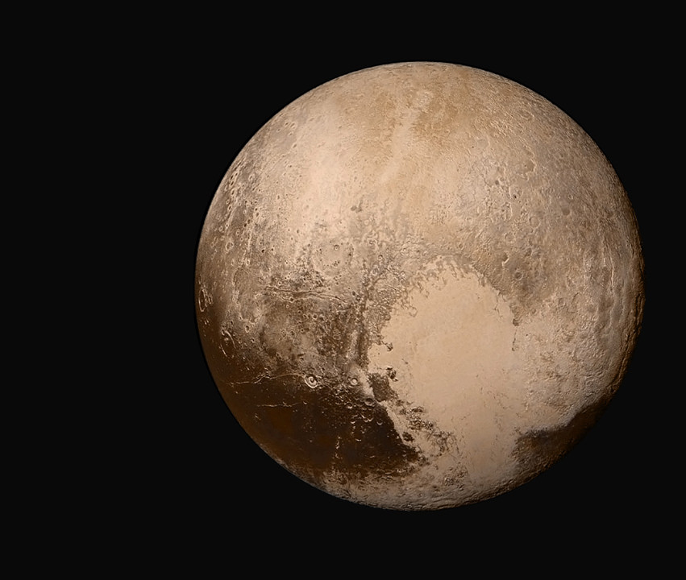
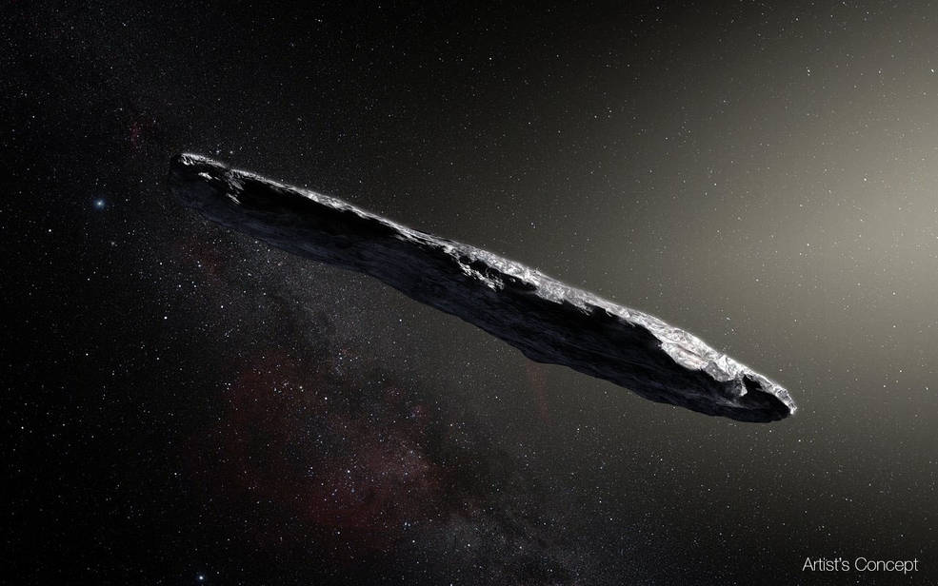
NASA/JHUAPL/SwRI
New Definitions
“(2) A "dwarf planet" is a celestial body that (a) is in orbit around the Sun, (b) has sufficient mass for its self-gravity to overcome rigid body forces so that it assumes a hydrostatic equilibrium (nearly round) shape, (c) has not cleared the neighbourhood around its orbit, and (d) is not a satellite.
(3) All other objects, except satellites, orbiting the Sun shall be referred to collectively as "Small Solar System Bodies".”
Oumuamua
https://www.iau.org/static/resolutions/Resolution_GA26-5-6.pdf
European Southern Observatory/M. Kornmesser
Notes:
interstellar asteroid 1I/2017 U1 (Oumuamua) 10:1 from where star Vega is now 400 metres long.

Slide 24
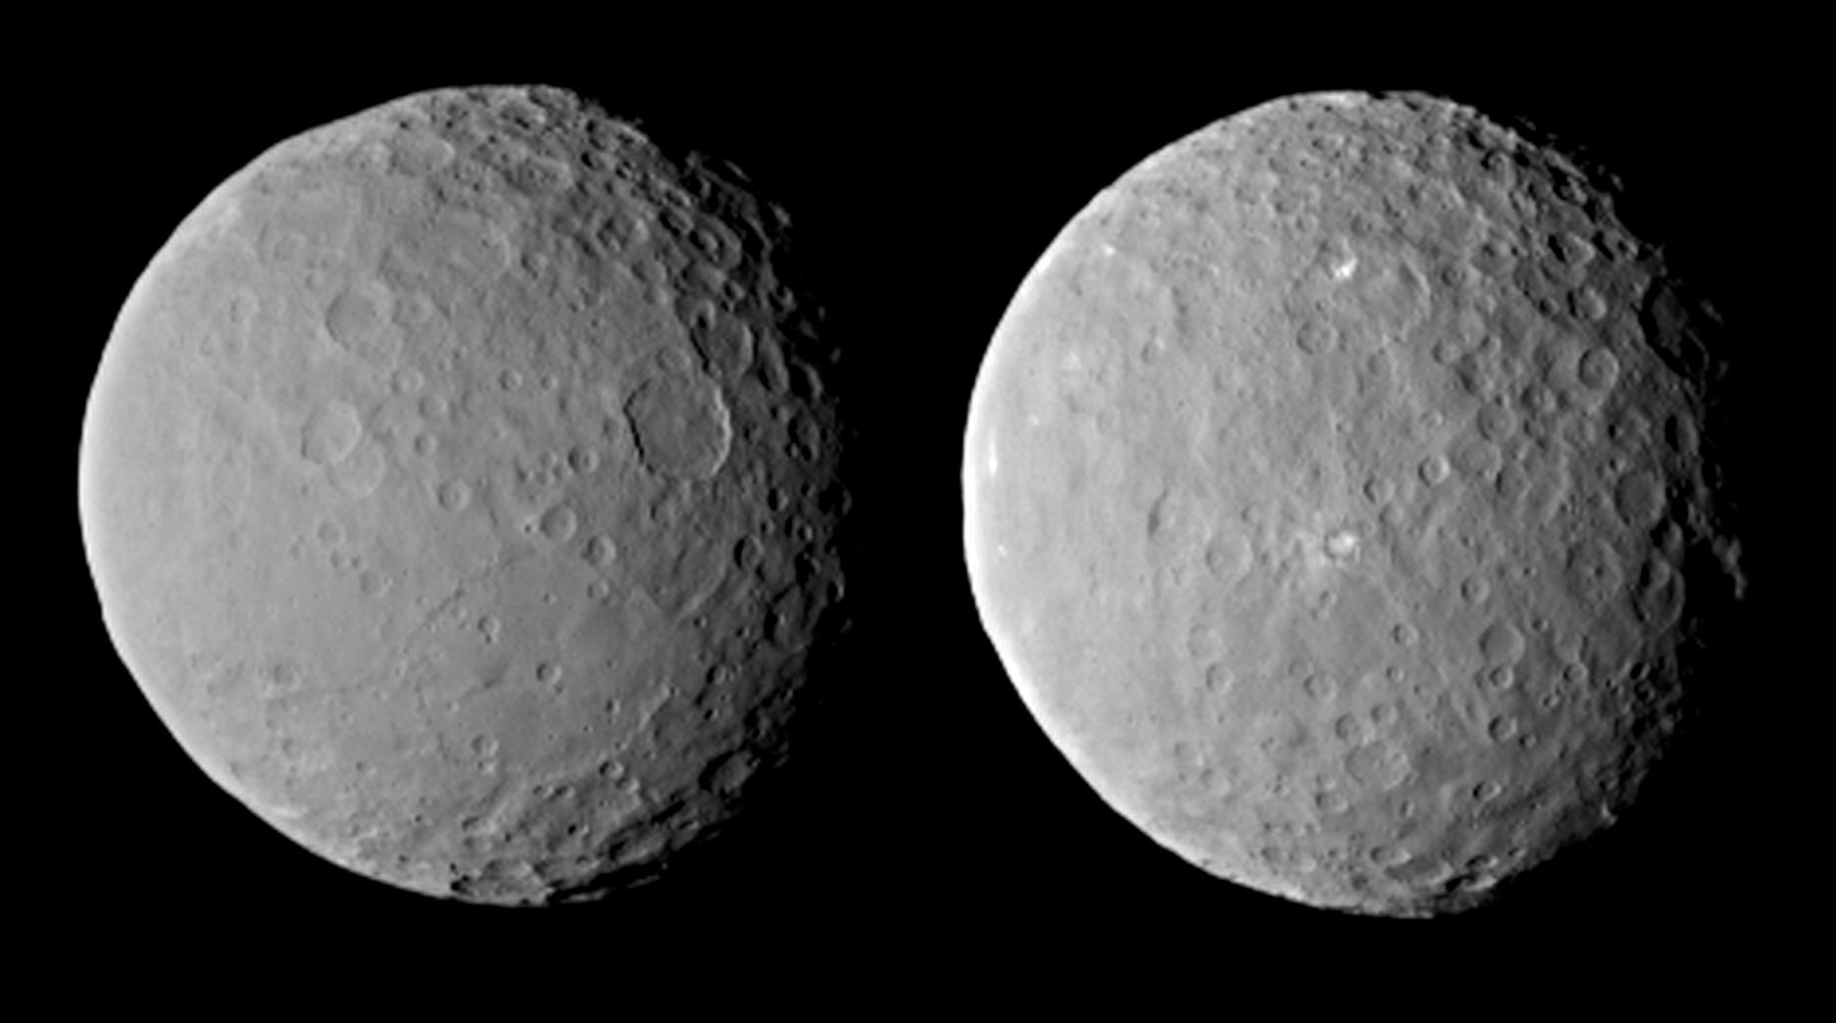
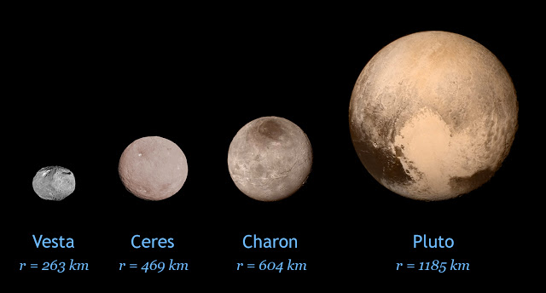
Ceres
Top Left: JPL/NASA
Bottom Right: http://backalleyastronomy.blogspot.co.uk/2015/07
Notes:
Ceres from NASA’s Dawn mission to the Asteroid belt (only non TNO dwarf)

Slide 25
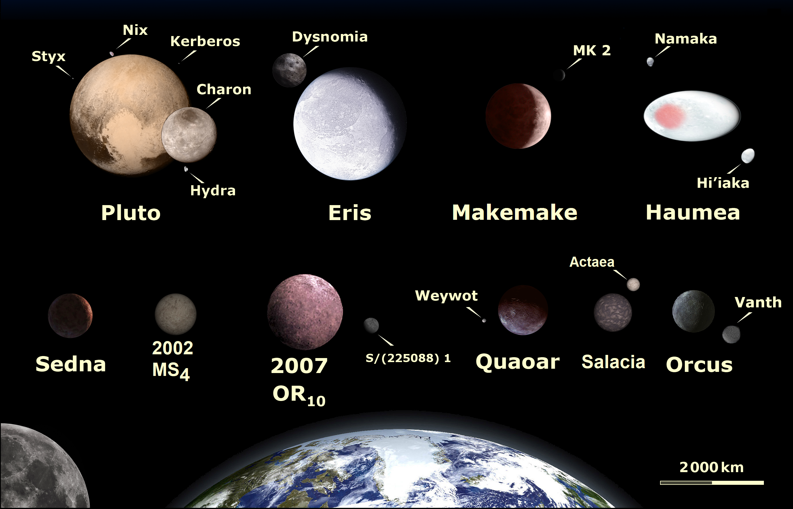
Largest Known TNOs
Lexicon/Wikipedia
adapted from work by
NASA, ESA, and A. Feild (STScI)
Notes:
Haumea collisional family, 7:12 resonance, 3.9 hr rotation

Slide 26
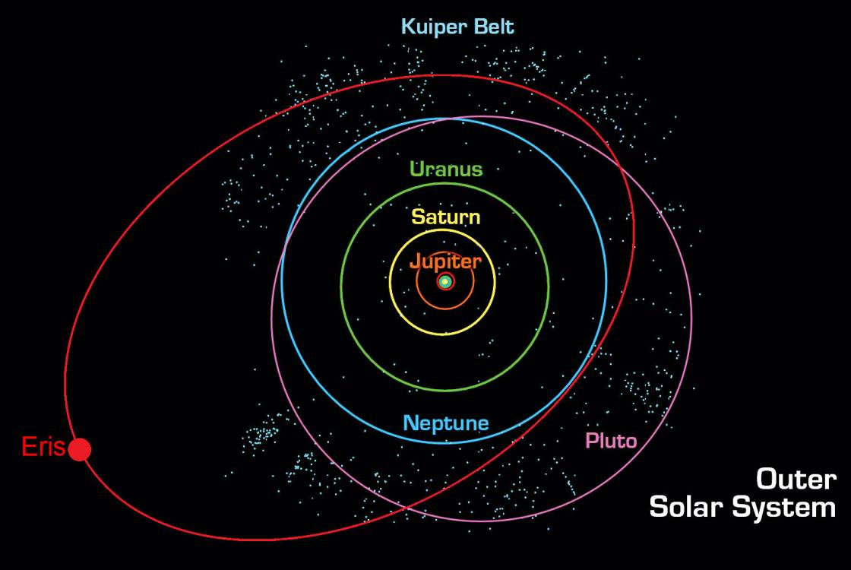

Slide 27
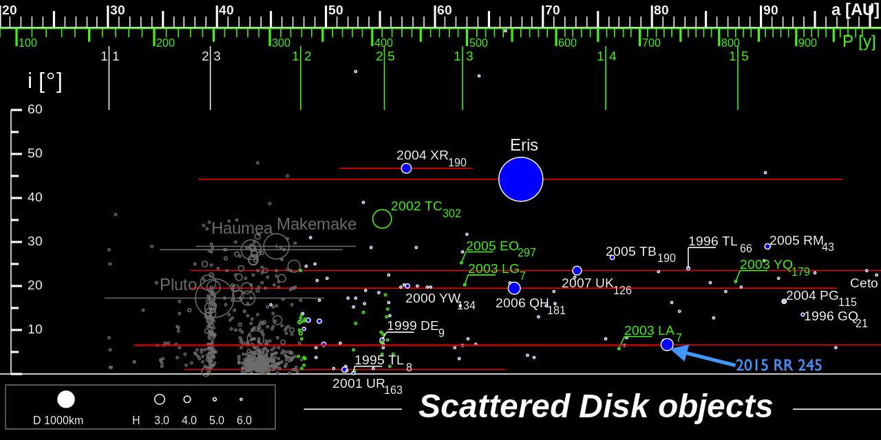
Eurocommuter~commonswiki
Notes:
All the planets lie in a plane (a disk) the scattered disk starts to thicken out and reach higher and lower above the planet’s plane – they are at a higher inclination.

Slide 28
Why is the Solar System structured this way?

Slide 29
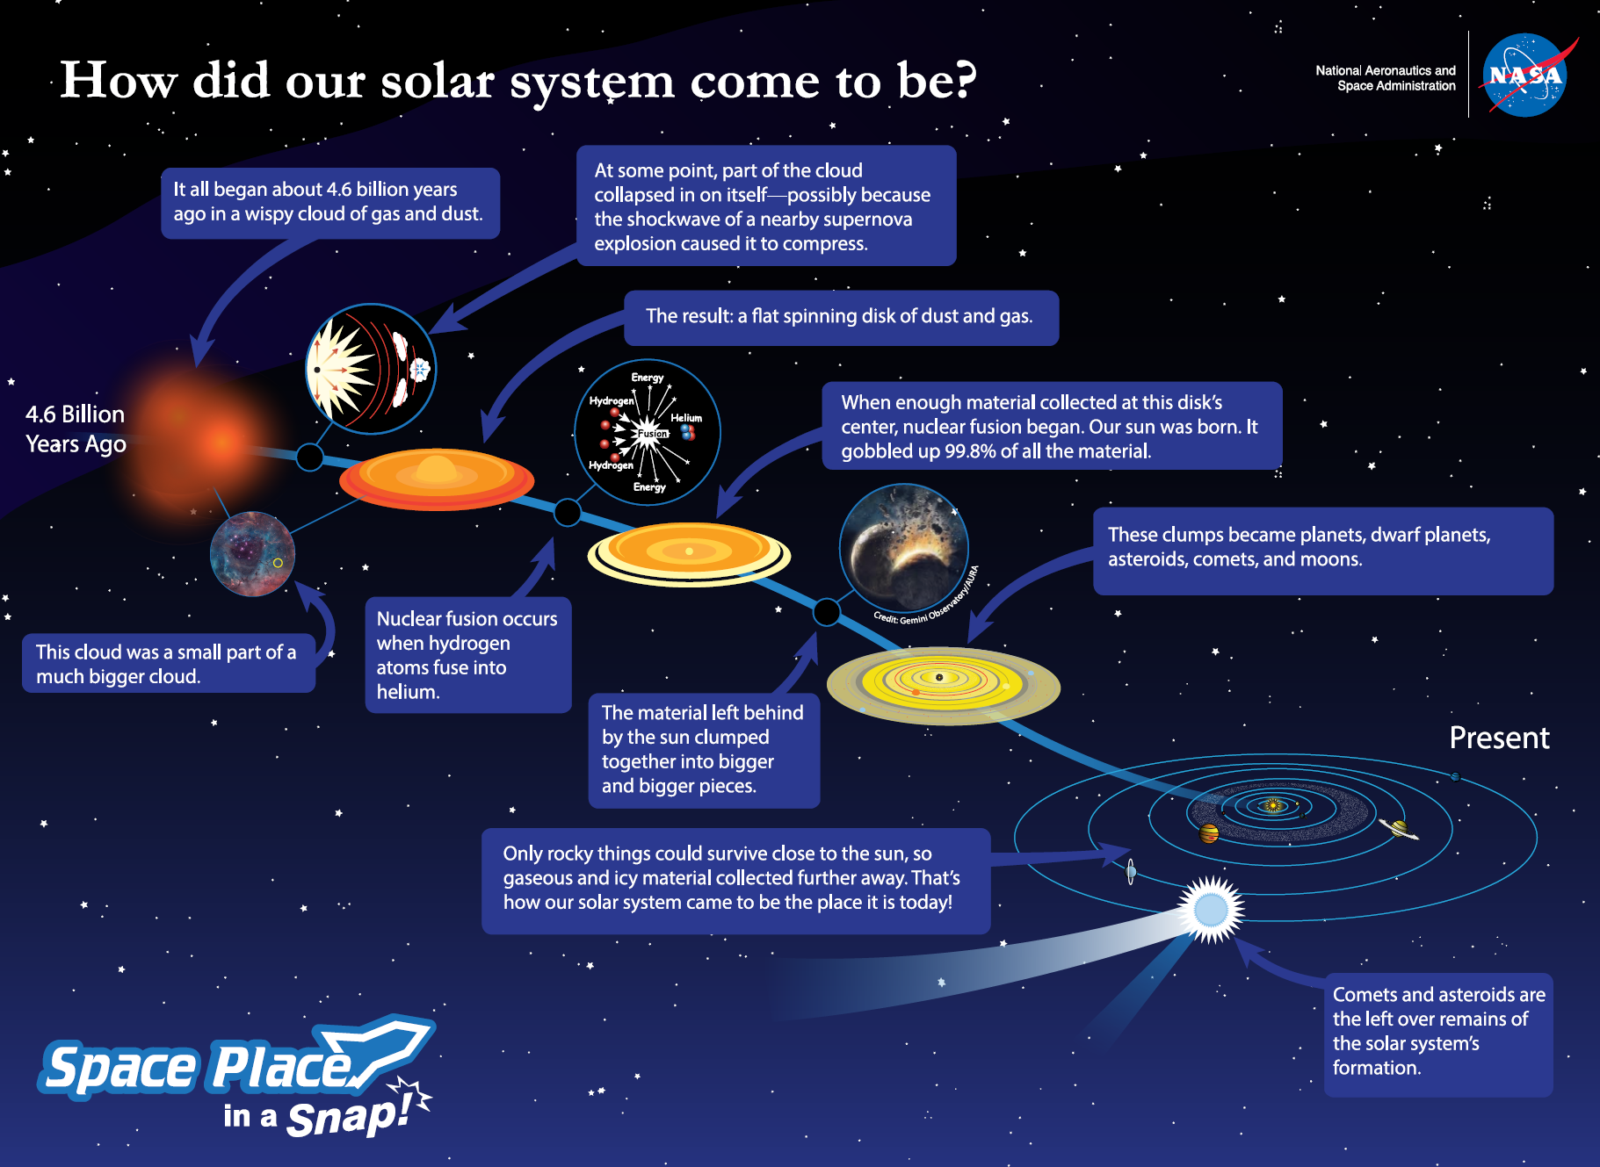
Notes:
Nice accompanying video on SS formation: https://www.youtube.com/watch?v=RT4OO0TFLHw&feature=emb_title

Slide 30
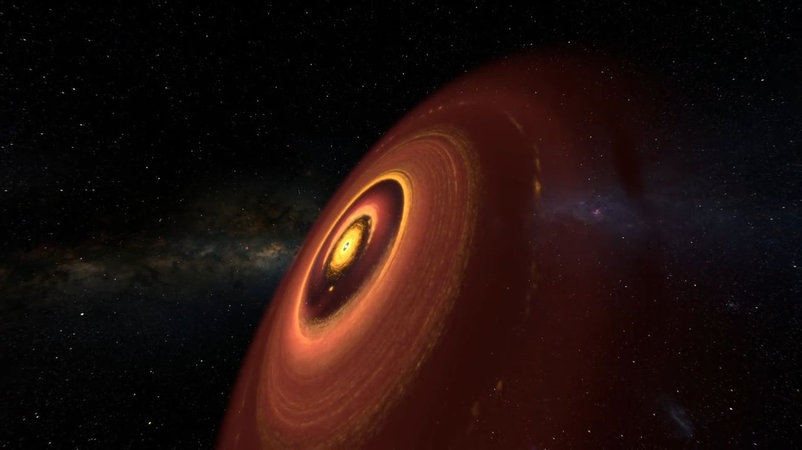
Solar System Formation
Notes:
Million years infall heating up disk EVOLUTION: then form small chunks – planetesimals – planetary embryo’s runaway growth. Clearing face dust cleared by embryo’s and planets. Neptune and Uranus swapped position!

Slide 31
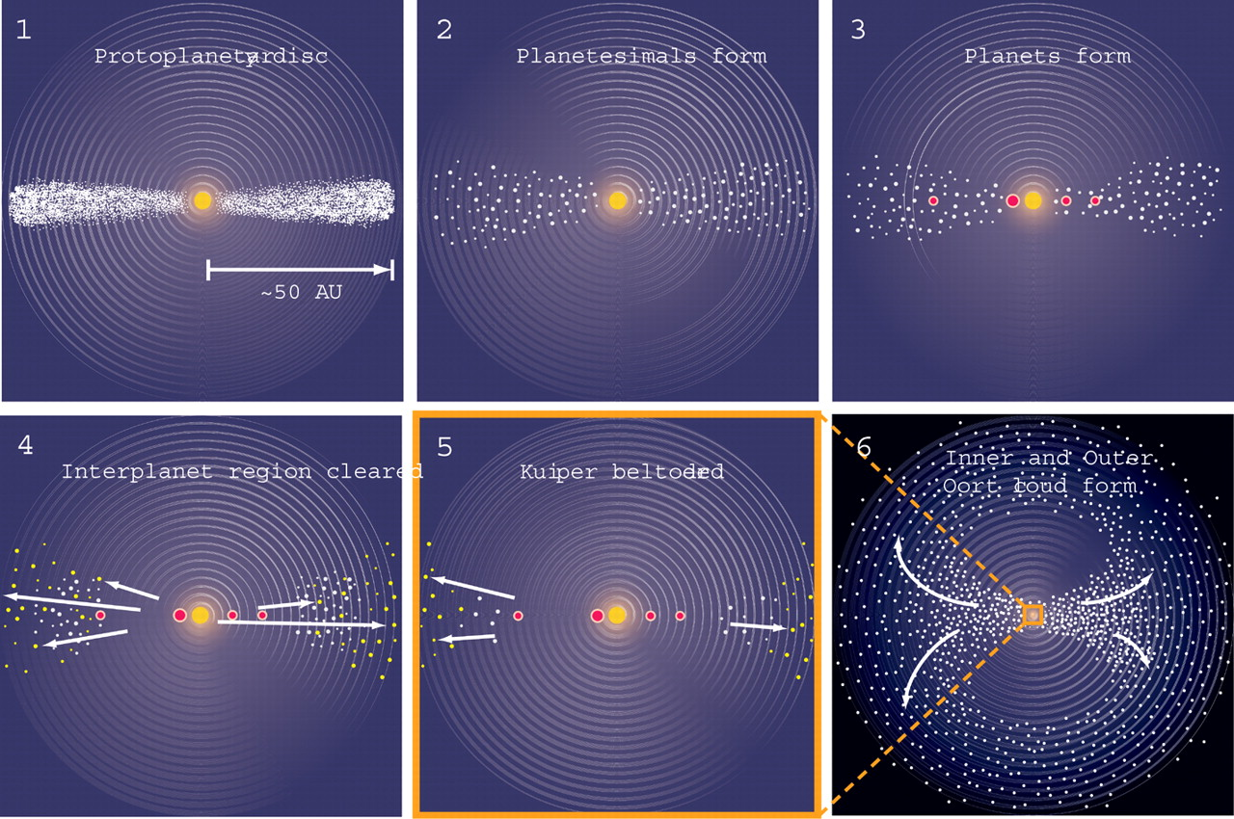

Slide 32
The Planets
Up next:

Slide 33
Name | Diameter | Distance from Sun | Length of Year:
Mercury | 4,879 km | 57,909,227 km | 88 Earth days
Venus | 12,104 km | 108,209,475 km | 225 Earth days
Earth | 12,742 km | 149,598,262 km | 365.24 days
Mars | 6,779 km | 227,943,824 km | 1.9 Earth years
Jupiter | 139,822 km | 778,340,821 km | 11.9 Earth years
Saturn | 116,464 km | 1,426,666,422 km | 29.5 Earth years
Uranus | 50,724 km | 2,870,658,186 km | 84.0 Earth years
Neptune | 49,244 km | 4,498,396,441 km | 164.8 Earth years
https://joshworth.com/dev/pixelspace/pixelspace_solarsystem.html

